Slide 1
Telescience WG
Report back
Shinji Shimojo
Fang-pang Lin

Slide 2
Presentations
"iHD1500:Low latency multipoint telepresence" Michael Wellings
“OPTIportal” Raj Singh
"TeleHVEM" Heon Yeom
“A method of data sharing in 2007 PRIME project and a study of its integration into NAREGI data grid environment.” Eisaku Sakane
“eScience Integrative Middleware system” YANG SHUO
“Ecogrid Update” Phang Pan Lin
“Weather Forecast Application on the Sensor Network” Seiichi Kato
“Initial design of a telemetering-based air quality monitoring system for Konkuk University” Jung-Hun Woo
“Streaming Data Applications & Middleware” Sameer Tilak
“Thinking about Provenance” Jim Myers, Luigi Marini, Joe Futrelle

Slide 3
Summery of WG
New Project
  more ubiquitous, and sensor-net type applications will launch on Korea and Japan
  Expanding use of senor network monitoring and storage technology
Tiled Display Wall
  Windows based Optiportal is developing and will be shown in SC07
  Integration with SAGE and streaming video may happen in SC07
  With Fine grained access control with Permis and GAMA
Realtime Video Streaming
  multiple HD streams with from different sources iHD1500 will be shown in SC07
Telescience platform for Microscope
  Goes to Sun Grid Engine
  Try to integrated with NAREGI
Identifying Middleware
  Optiportal
  RBNB
  Provenance

Slide 4
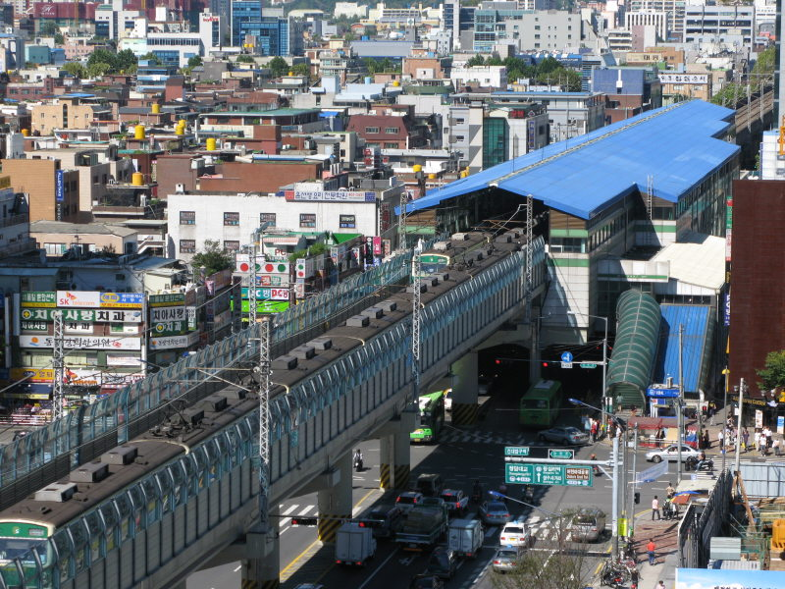
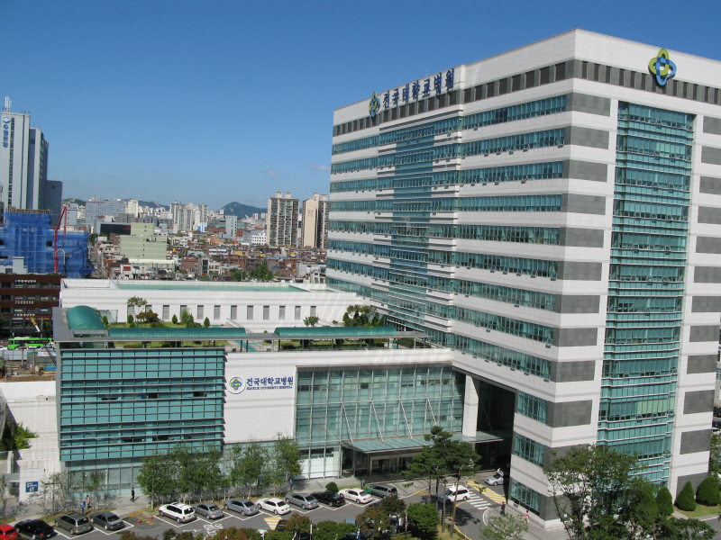
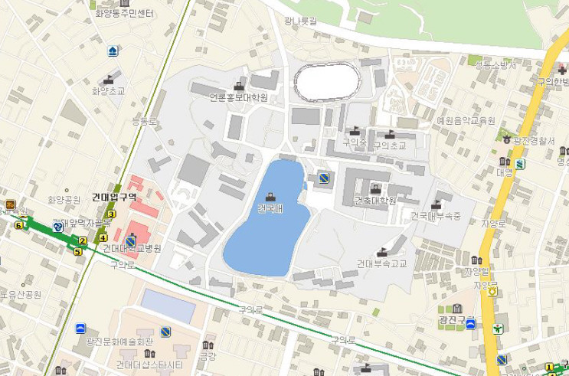
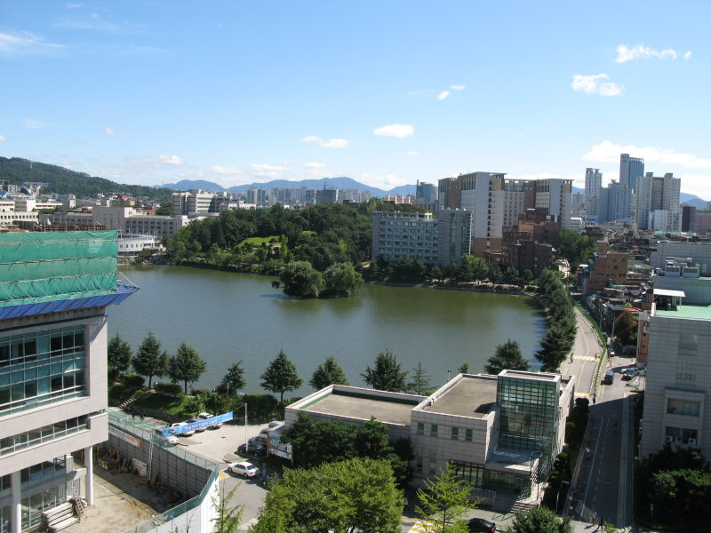
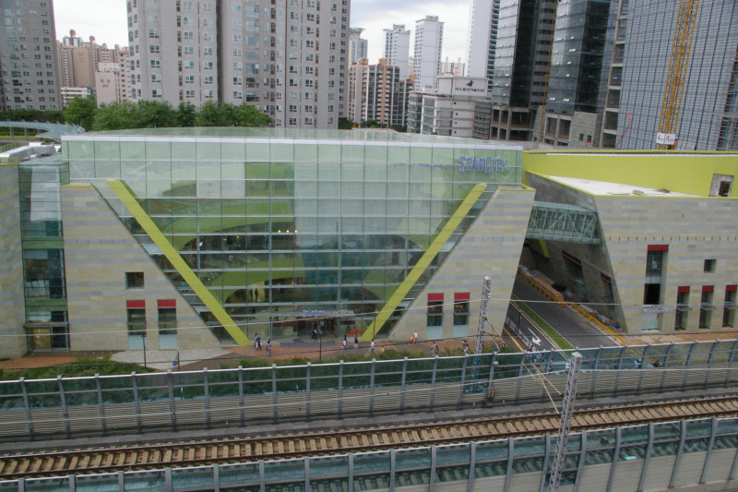
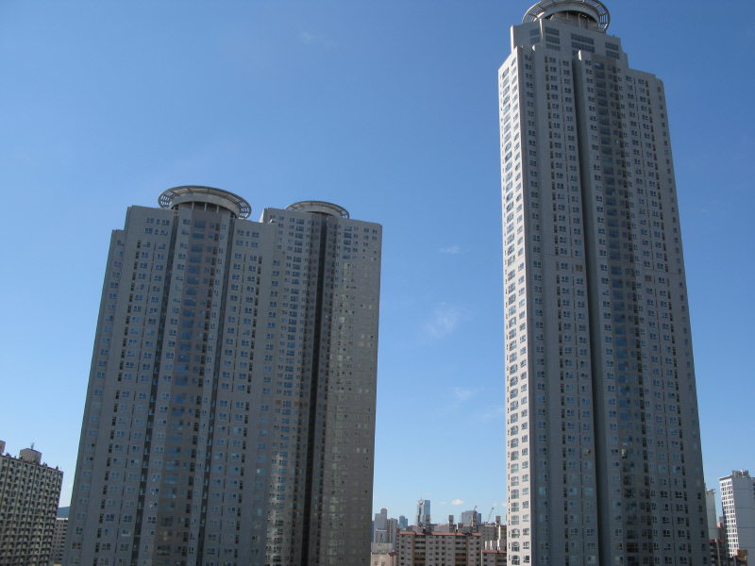
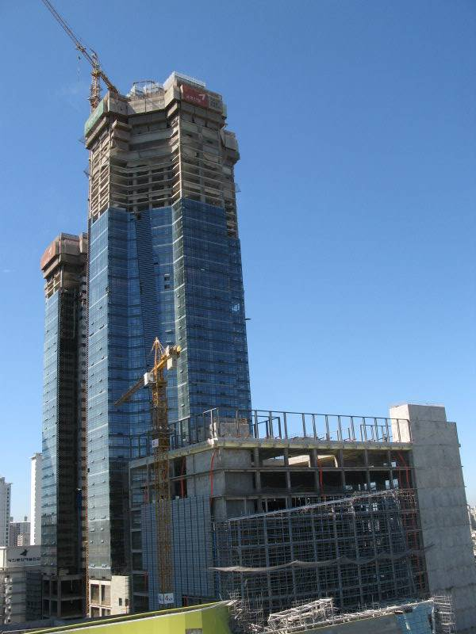

Konkuk University Complex (Seoul, Korea)
KUH
KU
Main Campus
DATF
Classic
500
Starcity (Com)
150m
Starcity (Res)
Jung-Hun Woo
Notes:
출처를 알아본다.

Slide 5


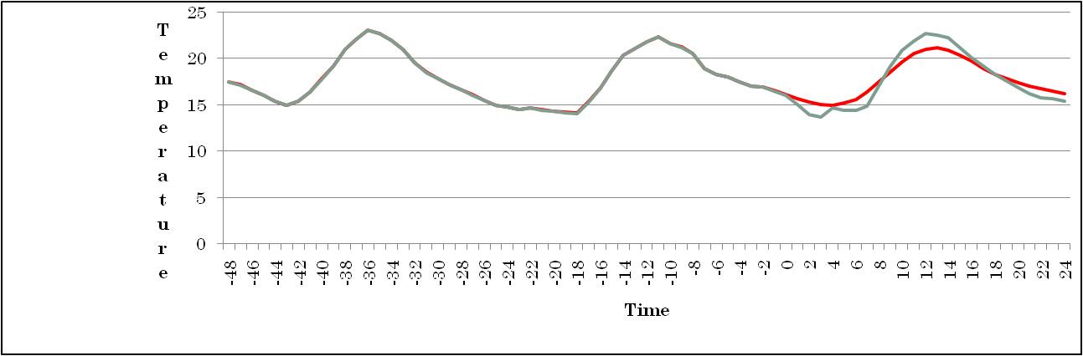
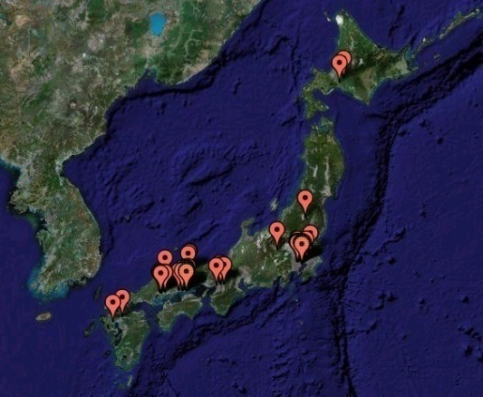
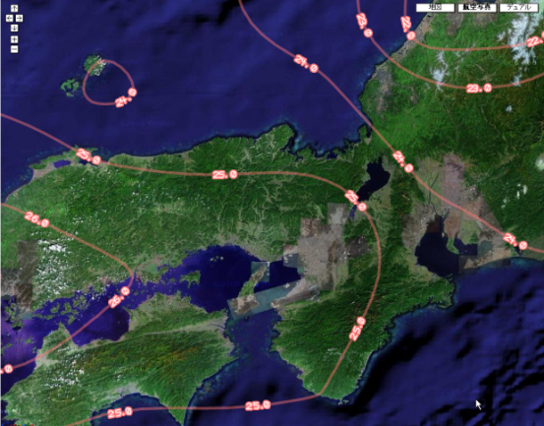
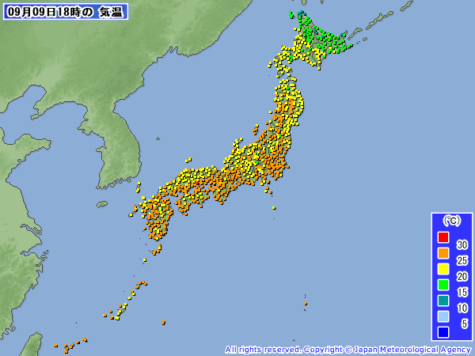

Prediction by AR(auto-regressive) model
Historical data
Obs. data
Prediction
Prediction by AR model is independent of the data of the other points.
Spatial interpolation give us the
data of the area where doesn’t have the sensor.
Seiichi Kato

Slide 6
SC2007: Nov, 2007
  Resources: <24/7 now>
    Feeds to 24x7 for multiple-stream server (8 streams, 1.5G each)/persistent connection. UW, CALIT2.
    GLEON/CREON testbed <YYL, Trout lake + others, e.g. Erken Lake> (NCHC)
    International Multiple-HDV feeds (All)
    Telescope remote control (Osaka, NCU?)
    Integrated with Tiled Display wall
  Data visualization
    Fluid Dynamics- 200GB- 2kx4k, 100K steps (Osaka)
  Technology development
    Multiple-data streaming to single TDW
  Sensor network Data sharing
  Take home assignment
    Listing your own projects’ architecture or framework in Wiki
    More collaboration with GeoScience !!!

